Slide 1
Earthquake prediction
Elnur Gasanov : 163411

Slide 2
Introduction

Slide 3

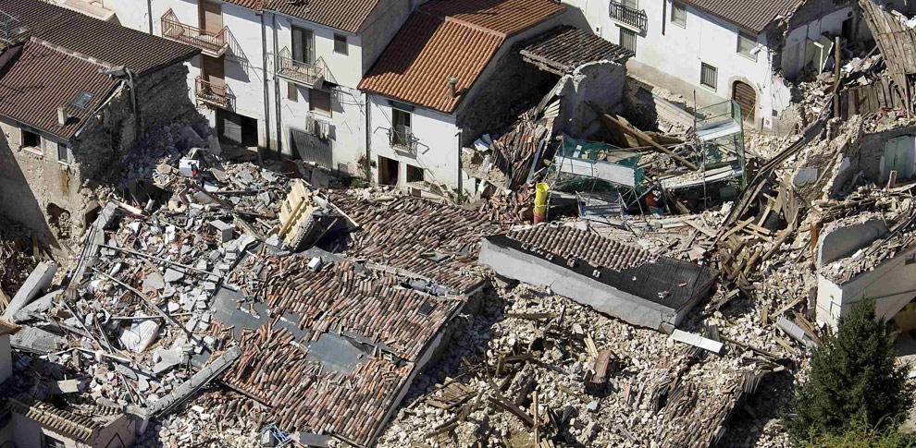
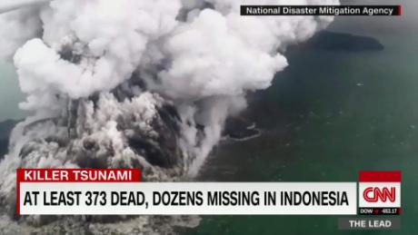

Slide 4
Data
Data matrix consists of 2 columns (feature: ”acoustic_signal” and label:”time_to_failure”) with 629145480 rows (number of samples).
Challenges: how to generate features and which models to choose

Slide 5
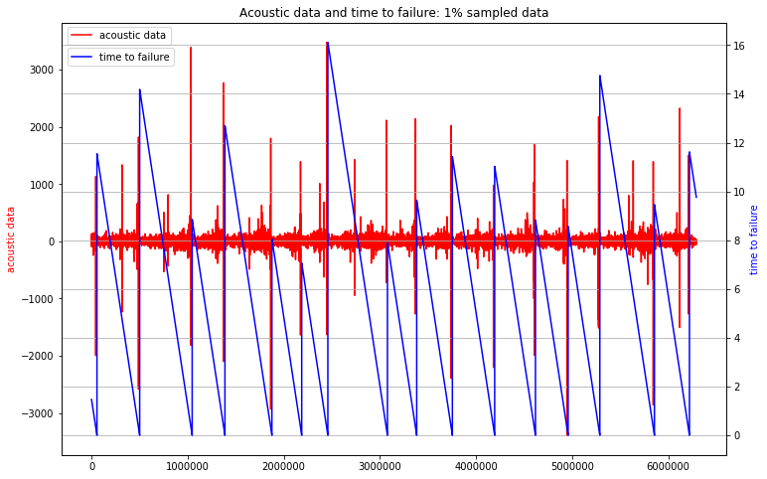

Slide 7
Related work

Slide 8
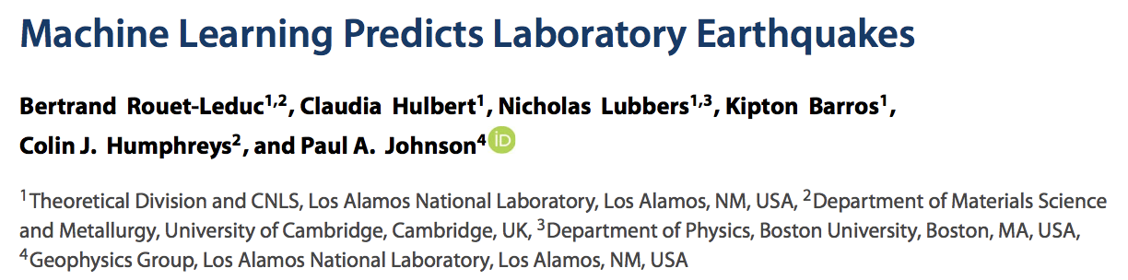
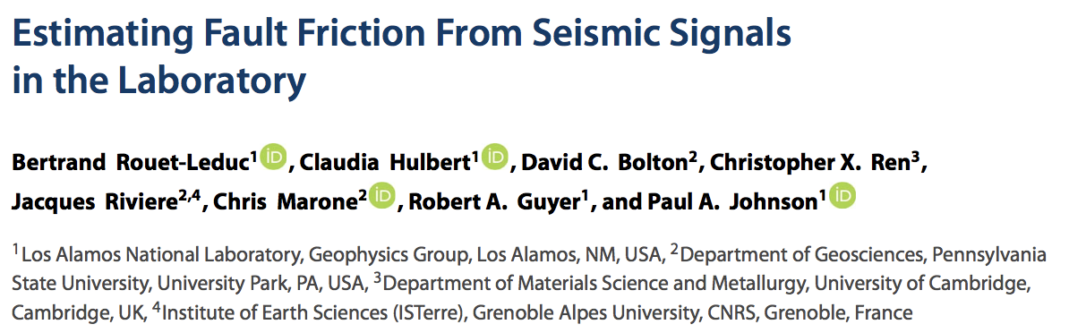

Slide 9
Solution

Slide 10
features
Basic features:
means, standard deviations, quantiles, maxs and mins of raw signal
the same features derived from time series of wavelet transform coefficients
(Morlet and Mexican Hat wavelets were used)
the same features derived from time series of Fourier series coefficients
different parameters of change rate

Slide 11
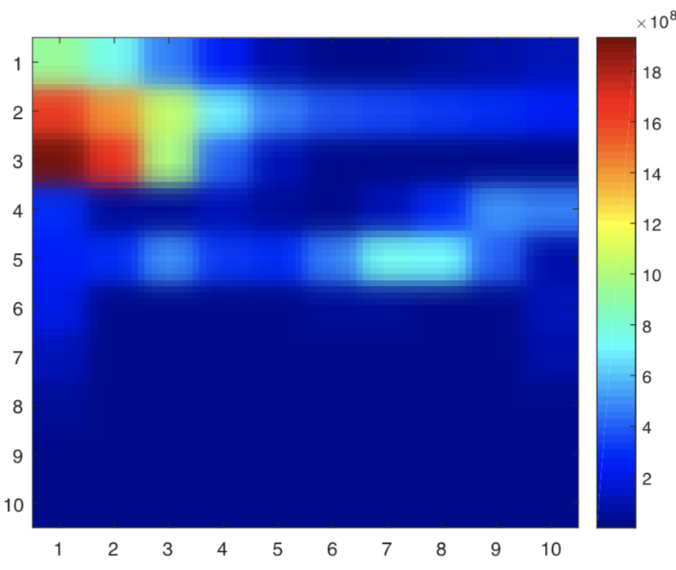
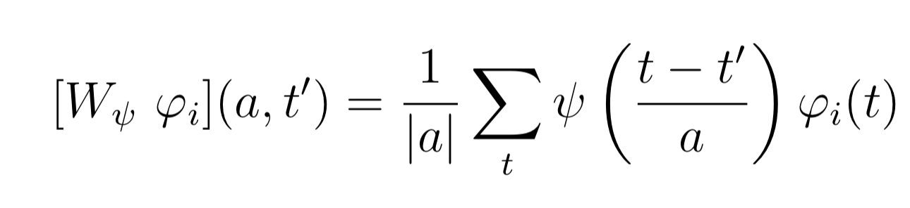
Wavelet transformation

Slide 12
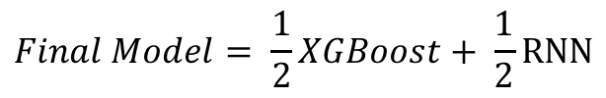
models
XGBoost – a standard model to train used in the papers: can approximate any measurable function but loses sequential nature of data
Recurrent Neural Network – takes into account sequential property of data but turns out to be hard to train in this problem
$$Final Model= \frac{1}{2}XGBoost+ \frac{1}{2}RNN$$

Slide 13
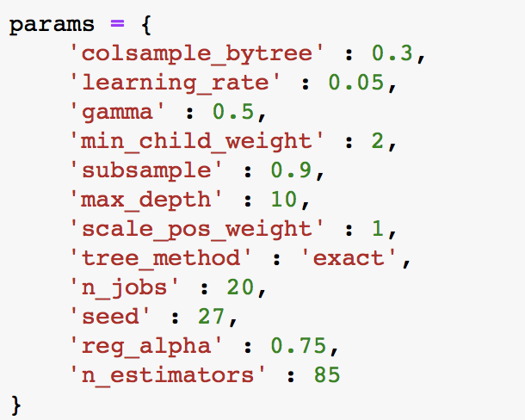
Training XGboost
Features for XGBoost are aggregated over 150k samples of initial input.
Tuned parameters:
max_depth, min_child_weight
gamma
subsample, colsample_by_tree
reg_alpha
n_estimators
Evaluation method: 5-fold cross-validation

Slide 14
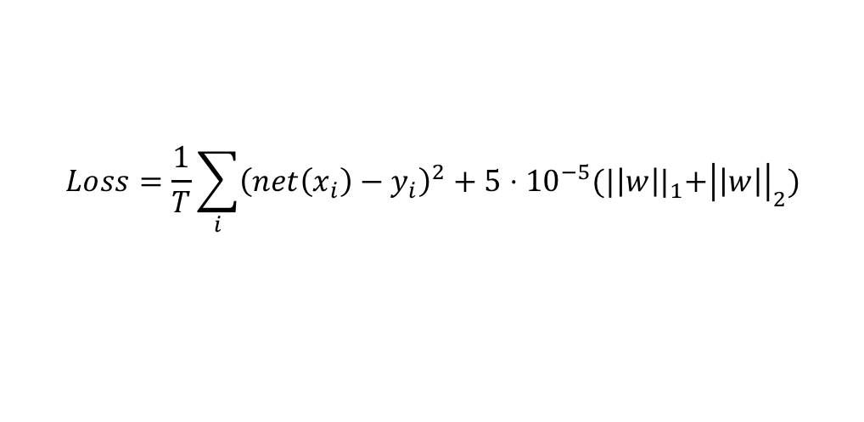
RNN
Features for RNN are aggregated over 30k samples of initial input. Feature matrix size is 20971x 465.
Two-layered LSTM network with 64 dimensional hidden input was chosen as a model.
Training last 40 epochs over whole data.
To avoid overfitting dropout layers and regularization were used.
$$Loss=\frac{1}{T}\sum_{i}{{\left(net\left(x_{i}\right)−y_{i}\right)}^{2}+5⋅{10}^{−5}{(|\left|w\right||}_{1}+{\left|\left|w\right|\right|}_{2})}$$

Slide 15
Results

Slide 16
Method | Mean absolute error
Baseline approach | 3.25
RNN | 2.43
XGBoost | 2.53
Combined model | 2.38
Best model of competition | 1.28*

Slide 17
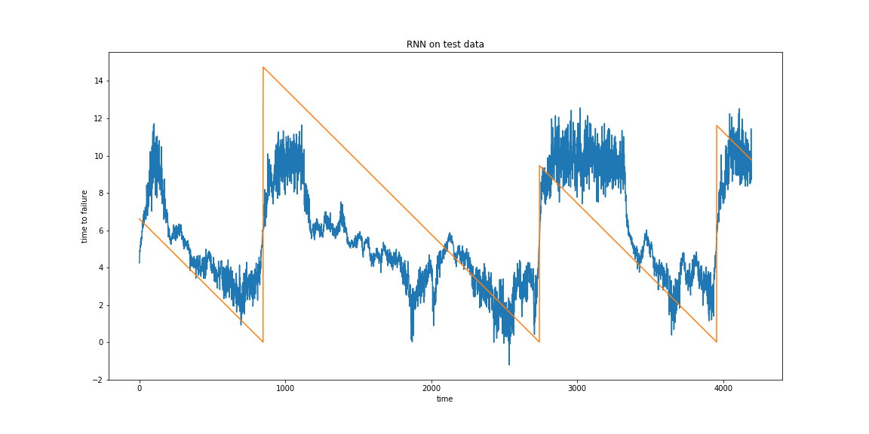
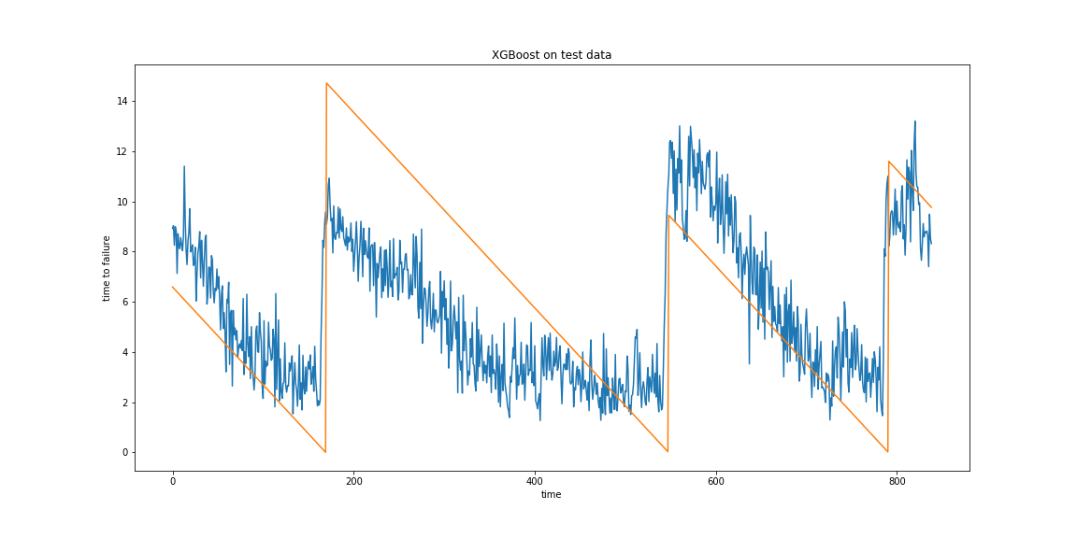

Slide 18
Conclusion and future work

Slide 19
The accuracy of the final model is better than accuracies of both models separately
The accuracy of the final model is by 26.7% better than the accuracy of baseline approach
Final model is still much worse than the best model of competition
Future work: to apply other techniques for avoiding overfitting when training RNN, to adjust weights of outputs of each model in the combined model

